Slide 1
Wine Dataset wine quality prediction
By Navya & Vaishnavi

Slide 2
Dataset Description
Number of independent variables are 11
Target variable is “quality” with six unique integer values
The highly skewed features are ‘chlorides’, ‘residual sugar’, ‘sulphates’, ‘total sulfur dioxide’, and ‘free sulfur dioxide’. Hence log transformation is applied for all these features.
Fixed acidity and density are the highest positively correlated features.
Citric acid and volatile acidity are the highest negatively correlated features.
There is a class imbalance in the dataset, and it was categorized by grouping the quality 3,4,5 into one group and 6,7,8 into another group.

Slide 3
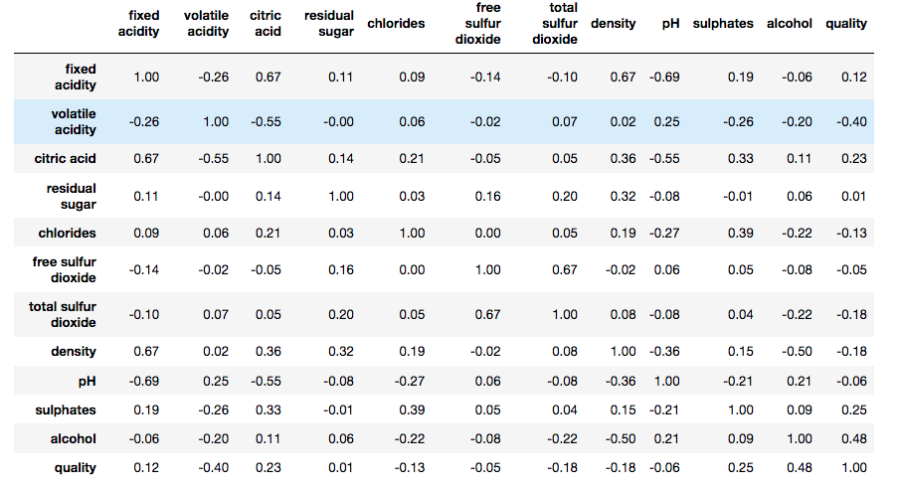
Main Statistics

Slide 4
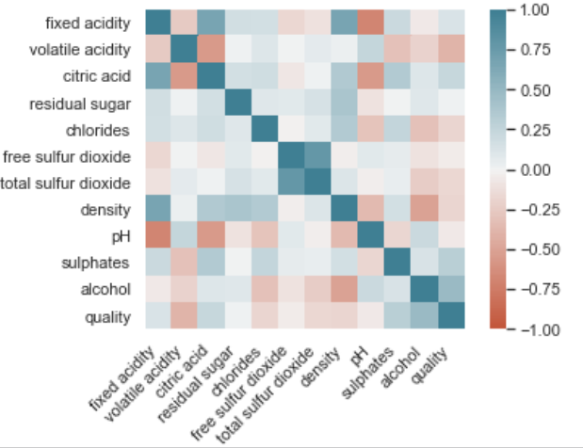
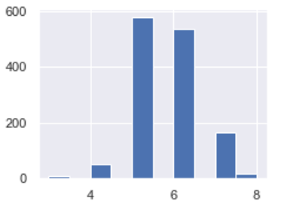
Dataset Visualization
Correlation Plot:
Class Imbalance:

Slide 5
ML Models
Logistic Regression:
It is a statistical method used to predict binary classes and to explain the relationship between the independent and dependent variables.
Hyper parameters used in the model implementation are C of range 0.01 to 1 and lbfgs optimizer.
KNN Algorithm:
It is a supervised machine learning algorithm used to solve both classification and regression tasks. It determines the class of the data point by majority voting principle.
Hyperparameter used in this model implementation is k of range 1 to 40.

Slide 6
ML Models
Support Vector Machine
It is a supervised Learning technique, which tries to find a hyper plane that maximizes the margin between the two classes in training data.
For wine data set, we used Linear kernel with penalty term C in the range 0.1 to 1000.
Random Forest:
It is an ensemble method, which makes predictions based on multiple decision trees by using bootstrapping technique.
We used grid search method to find the best parameters (tree depth, split criteria etc.)

Slide 7
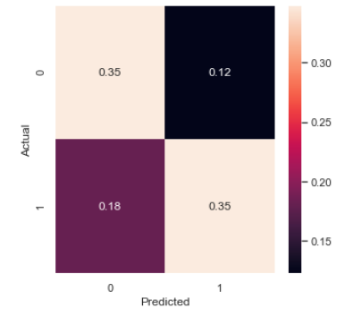
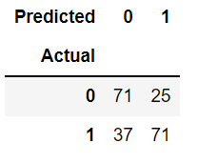
Results of Logistic Regression
Accuracy on validation data - 69.6%
Confusion Matrix:
Precision is 73.95%

Slide 8
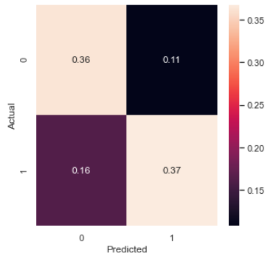
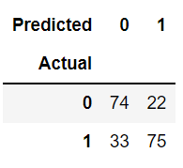
Results of KNN Algorithm
Accuracy on validation data - 73.03%
Confusion Matrix:
Precision on validation data - 77.31%

Slide 9
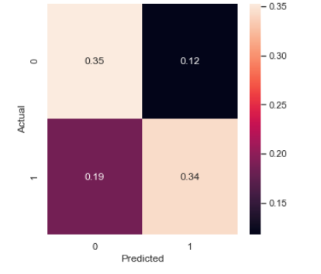
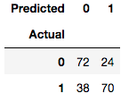
Results of SVM
Accuracy on validation data – 69.60%
Confusion Matrix:
3. Precision on validation data – 74.46%

Slide 10
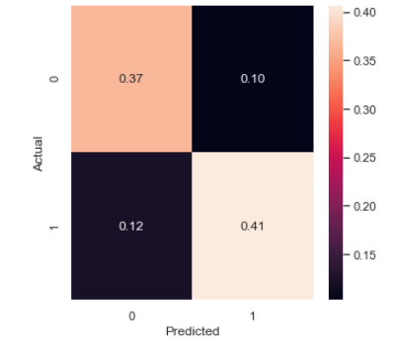
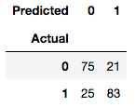
Results of Random Forest
Accuracy on validation data – 77.45%
Confusion Matrix
Precision on validation data - 79.80%

Slide 11
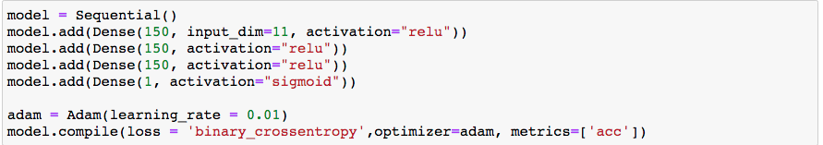
Neural Network (Bonus)
A neural network is a series of algorithms used to recognize hidden pattern and correlation in the raw data. Hyperparameters used in the implementation are the number of hidden layers, learning rate, activation functions and the optimizers.
Accuracy is 76.25% for the neural network with 2 hidden layers, relu activation function and Adam optimizer with learning rate of 0.01.

Slide 12
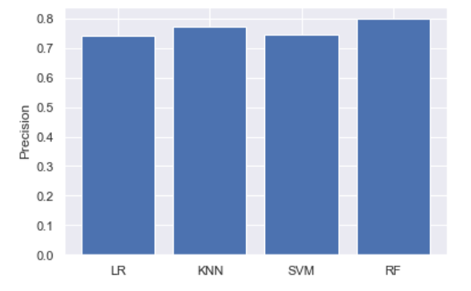
Key Observations
Random Forest algorithm performed better than the logistic regression, KNN, and SVM with precision of 72.46% on the test data.

Slide 13
Team Contribution
Team Member | Assignment Part | Contribution
Navya | Data Analysis | 50%
Vaishnavi | Data Analysis | 50%
Vaishnavi | Model Implementation – LR, KNN | 100%
Navya | Model Implementation – SVM, RF | 100%
Navya | Neural Network Implementation | 50%
Vaishnavi | Neural Network Implementation | 50%

Slide 14
THANK YOU

